Slide 1


Data-Driven Insights of an Online Store
John Kiran, Data Analyst

Slide 2
Today’s Agenda
Project Recap
Process
The Analytics Team
Visualisations
Recommendations

Slide 3

Project Recap
The business of “Online Retail Store” has been performing well and the management wants to analyse what the major contributing factors are to the revenue so they can strategically plan for next-year. It has enlisted our consultancy to Analyse data and offer strategic guidance to the CEO and CMO.
Requirements:
The monthly trend of revenue and highlight months with significant increases or decreases.
The top 10 revenue generated by different countries to identify top-performing and underperforming ones.
The top 10 customers by revenue, excluding those without customer ids, sorted in descending order.
Demand for products across countries, excluding the UK, highlighting total units sold or country names.

Slide 4
The Process
Data Collection
Data Cleanup & Modelling
Data Analysis
Recommendations
Gathering relevant datasets from resources and understanding the variables in that data
Create a check that the quantity should not be below 1 unit and the Unit price should not be below $0
Utilizing statistical methods to uncover patterns, trends, and insights within the data.
Presenting actionable insights through effective visualization techniques, ultimately driving informed decision-making and business success.

Slide 5



Meet our team
John Kiran
Flora Berggren
Data Analyst
Takuma Hayashi
Business strategy and Marketing specialist
Chief Technical Architect

Slide 6
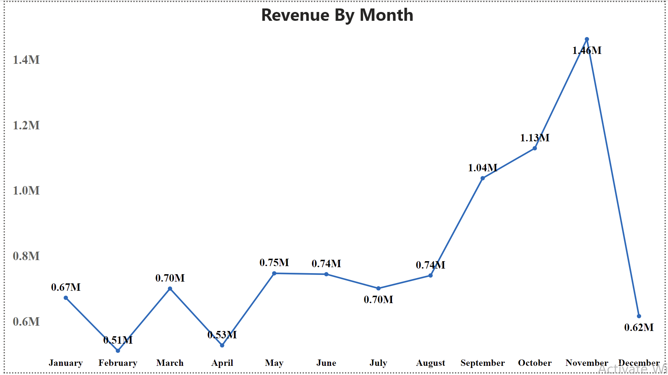
The monthly trend of revenue

Slide 7
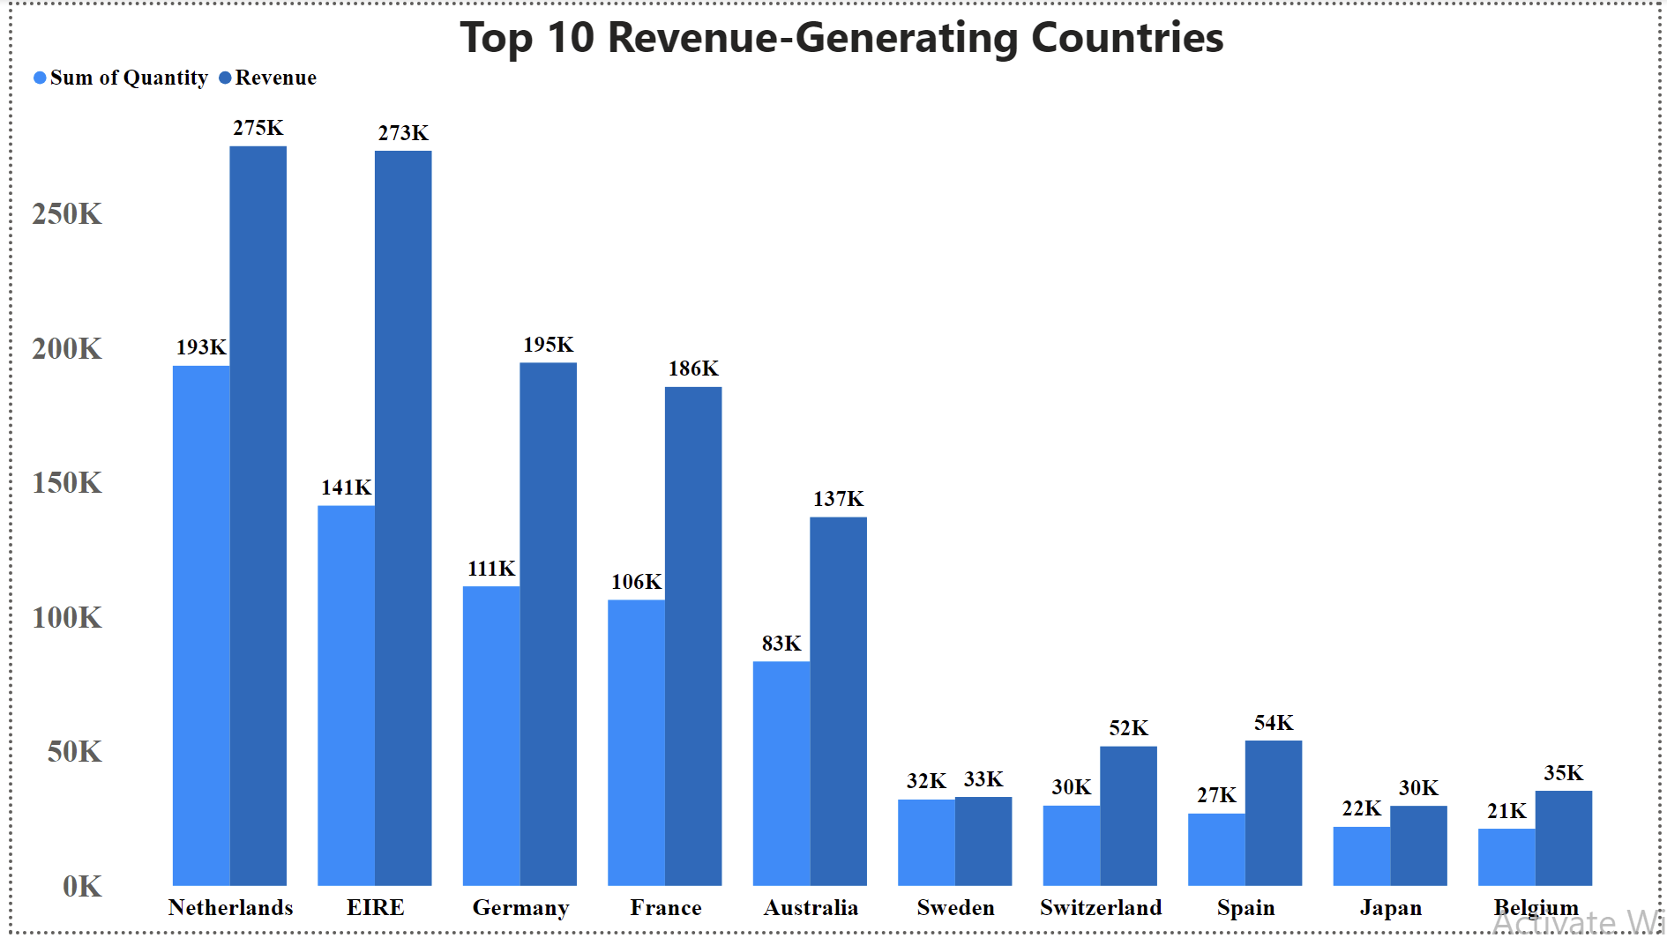
The top 10 revenue generated countries

Slide 8
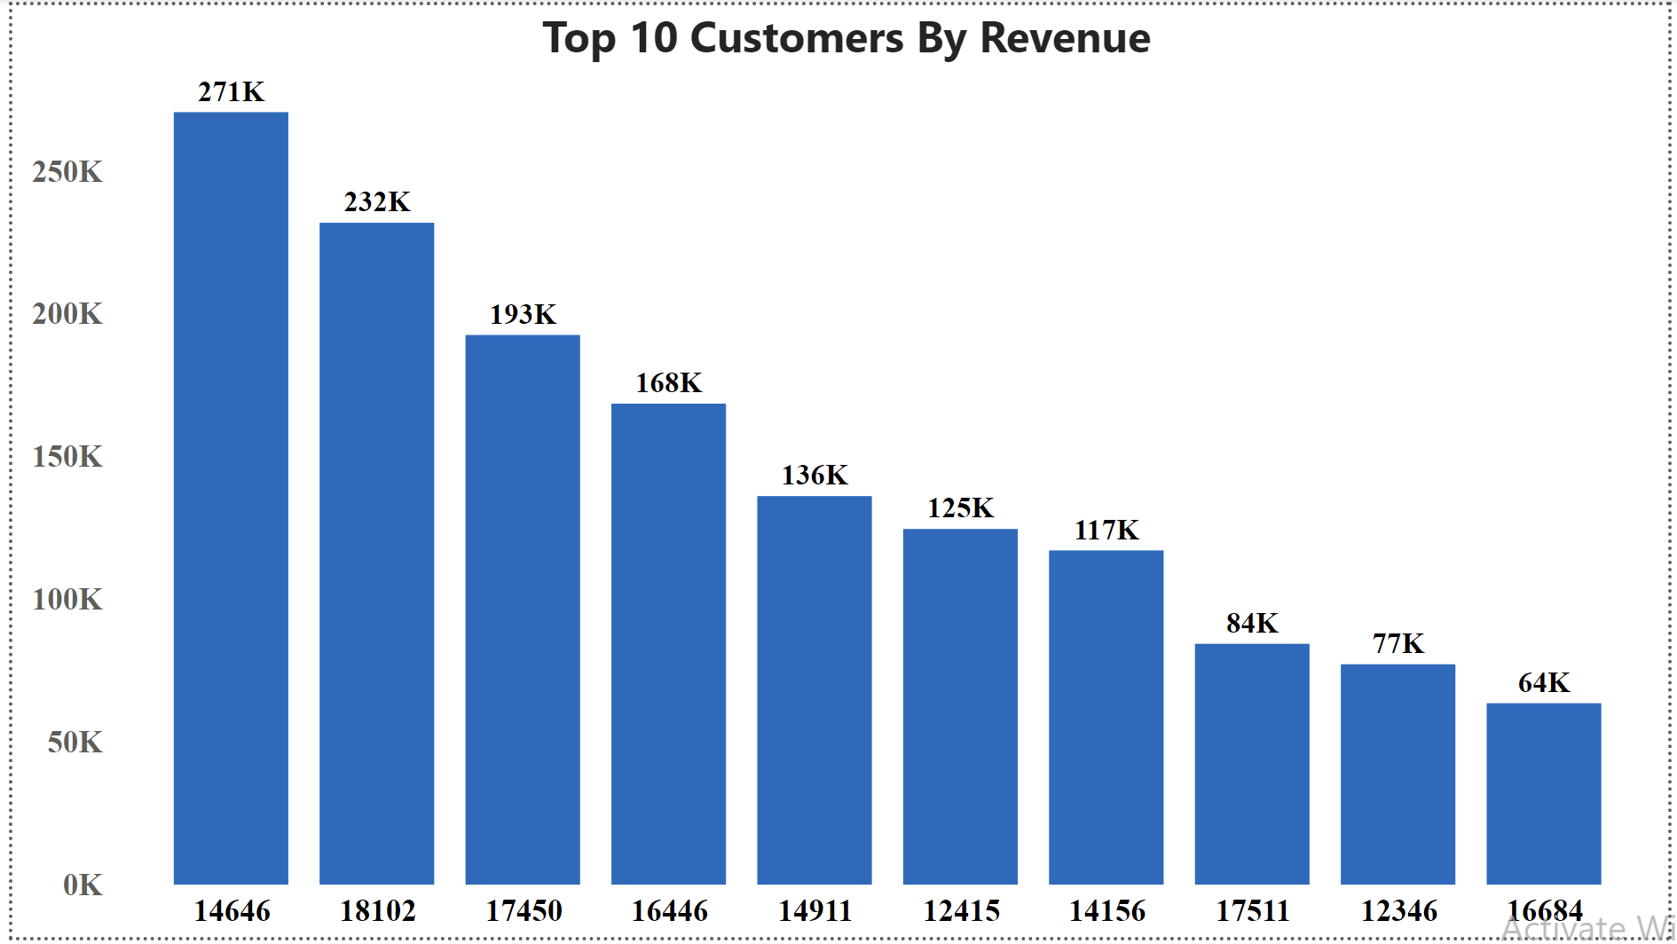
The top 10 customers by revenue

Slide 9
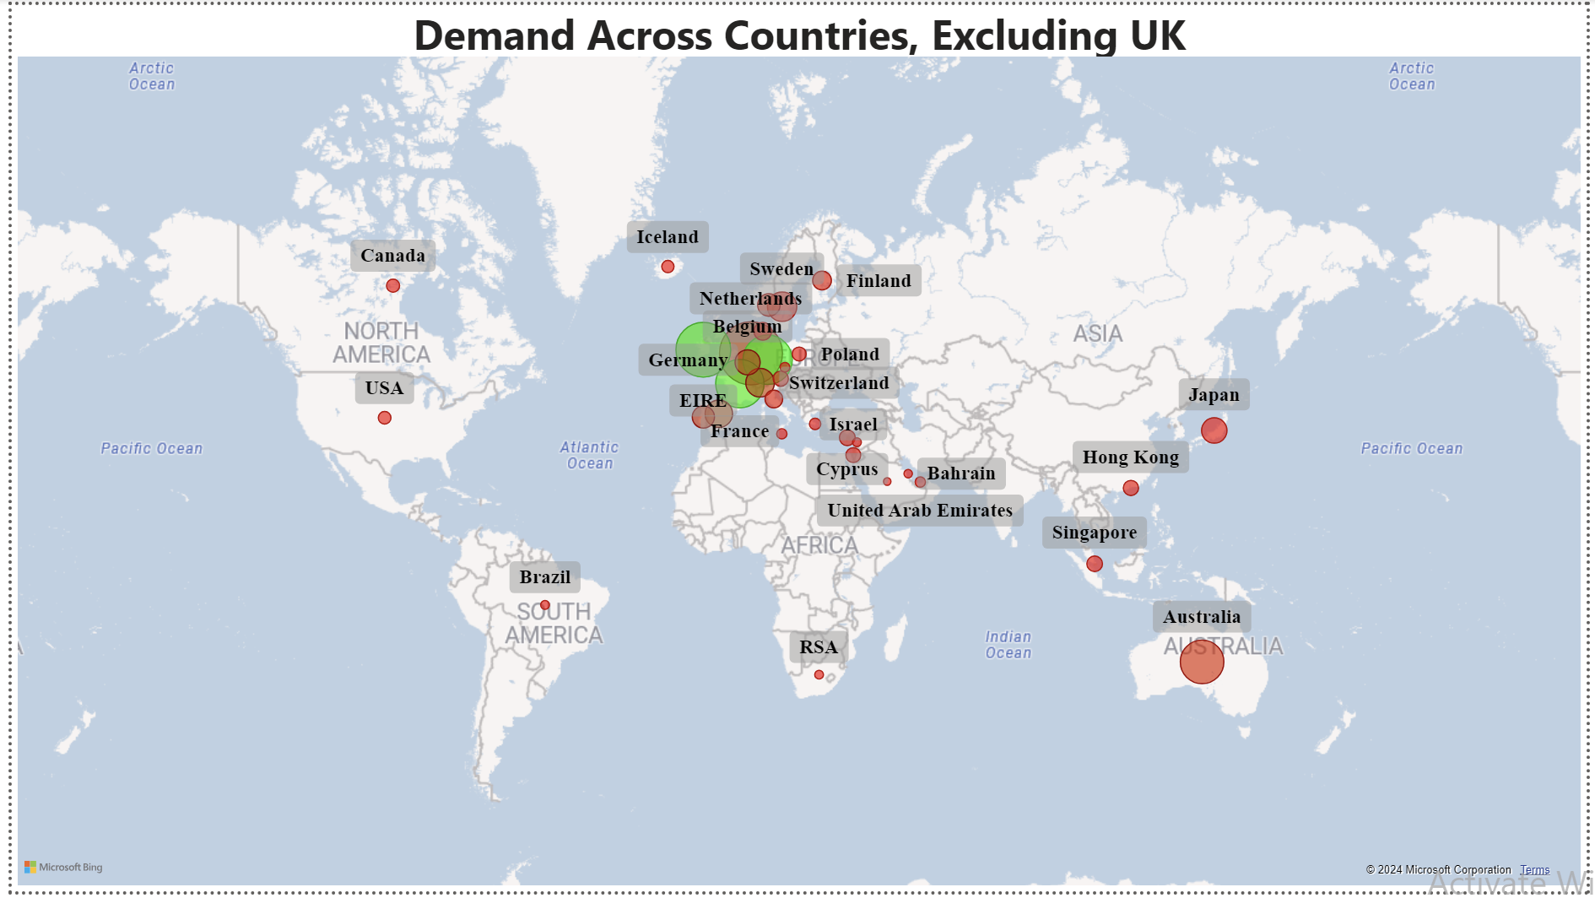
Demand for products across countries, excluding the UK

Slide 10

Recommendations
The company should come up with strategies that aim at stocking and advertising seasonal products to maximize sales when the demand goes up. (especially in the last quarter)
The company should create special relationship with the customers who order in big quantities to increase the retention by giving discounts and offers.
The European market has more potential to grow sales hence company should build strategies to maximize the sales in this region.

Slide 11




Thank you
Open for Questions!

